Slide 1
Lecture 5: Image formation
Notes:
Representation learning.
What representations are learned by deep nets?
Transfer learning: How you can transfer a representation from one task to another?
Finally: how can you learn representations?

Slide 2
Today
Reminder: PS1 due today - submit on Canvas
No extensions just gets counted toward late days after midnight
Generous late day policy just tracks if you are behind
>14 days late over the course requires meetings with teaching staff
PS2 released today - available on Canvas after class
Quizzes start next week
Notes:
In the course so far, we’ve talked We’re going to begin a new section of the course. We’re gonna go back to the basics and talk about physical models for vision.
A lot of the methods that exploit these physical models are very different from the deep learning and filtering methods that you’ve seen so far.
Some of the most useful computer vision methods combine these deep learning techniques with physical constraints.
Today we’re going to talk a bit about the geometry behind cameras
And we’re going to study how 3D points in a scene get projected as 2D points in images

Slide 3
Today
Staffing Update - GSI change:
    https://www.eecs.umich.edu/courses/eecs442/fa25/
Camera models
Projection equations
Notes:
In the course so far, we’ve talked We’re going to begin a new section of the course. We’re gonna go back to the basics and talk about physical models for vision.
A lot of the methods that exploit these physical models are very different from the deep learning and filtering methods that you’ve seen so far.
Some of the most useful computer vision methods combine these deep learning techniques with physical constraints.
Today we’re going to talk a bit about the geometry behind cameras
And we’re going to study how 3D points in a scene get projected as 2D points in images

Slide 4
The structure of ambient light
Source: Freeman, Torralba, Isola
Notes:
We can start by asking, what in the world is there to see.
90 million miles
Sun is shining
Its light is reflecting off objects

Slide 5

The structure of ambient light
What information does this light provide?
Source: Freeman, Torralba, Isola
Notes:
What information about the world is provided in the light filling a region of space?

Slide 6
The Plenoptic Function
Adelson & Bergen, 91
light field
The intensity P can be parameterized as:
P
(
X, Y, Z
)
Eye position
Source: Freeman, Torralba, Isola
Notes:
What information about the world is provided in the light filling a region of space?
We can parameterize this using what’s known as the plentopic function. Plen meaning complete. also called light field
Set of light rays that go through a point in space: pencil
Plen = complete
The significance of the plenoptic function is this: The world is made of three-dimensional objects, but these objects do not communicate their properties directly to an observer. Rather, the objects fill the space around them with the pattern of light rays that constitutes the plenoptic function, and the observer takes samples from this function. The plenoptic function serves as the sole communication link between physical objects and their corre- sponding retinal images.

Slide 7
The Plenoptic Function
Adelson & Bergen, 91
The intensity P can be parameterized as:
P
(θ, φ,
X, Y, Z)
Angle
Source: Freeman, Torralba, Isola
Notes:
What information about the world is provided in the light filling a region of space?
Set of light rays that go through a point in space: pencil
The significance of the plenoptic function is this: The world is made of three-dimensional objects, but these objects do not communicate their properties directly to an observer. Rather, the objects fill the space around them with the pattern of light rays that constitutes the plenoptic function, and the observer takes samples from this function. The plenoptic function serves as the sole communication link between physical objects and their corre- sponding retinal images.

Slide 8
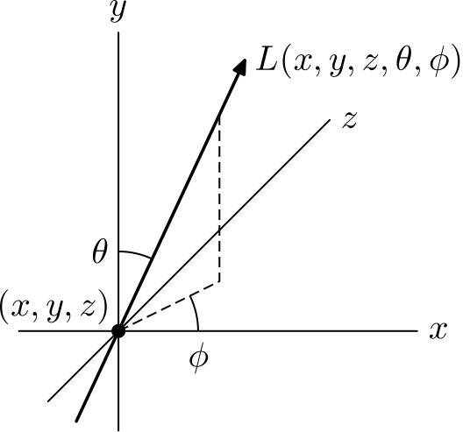
Ray Parameterization

Slide 9
The Plenoptic Function
Adelson & Bergen, 91
The intensity P can be parameterized as:
P
(θ, φ,
λ,
t,
X, Y, Z)
Wavelength, time
Source: Freeman, Torralba, Isola
Notes:
This ideally
What information about the world is provided in the light filling a region of space?
Set of light rays that go through a point in space: pencil
The significance of the plenoptic function is this: The world is made of three-dimensional objects, but these objects do not communicate their properties directly to an observer. Rather, the objects fill the space around them with the pattern of light rays that constitutes the plenoptic function, and the observer takes samples from this function. The plenoptic function serves as the sole communication link between physical objects and their corre- sponding retinal images.

Slide 10
The Plenoptic Function
Adelson & Bergen, 91
The intensity P can be parameterized as:
P
(θ, φ,
λ,
t,
X, Y, Z)
Full plenoptic function
Source: Freeman, Torralba, Isola
Notes:
Of course, if we were able to capture this full function, that would contain all of the information an image could possibly tell us.
But images you take with a camera represent only a tiny sliver of this function.
What information about the world is provided in the light filling a region of space?
Set of light rays that go through a point in space: pencil
The significance of the plenoptic function is this: The world is made of three-dimensional objects, but these objects do not communicate their properties directly to an observer. Rather, the objects fill the space around them with the pattern of light rays that constitutes the plenoptic function, and the observer takes samples from this function. The plenoptic function serves as the sole communication link between physical objects and their corre- sponding retinal images.

Slide 11
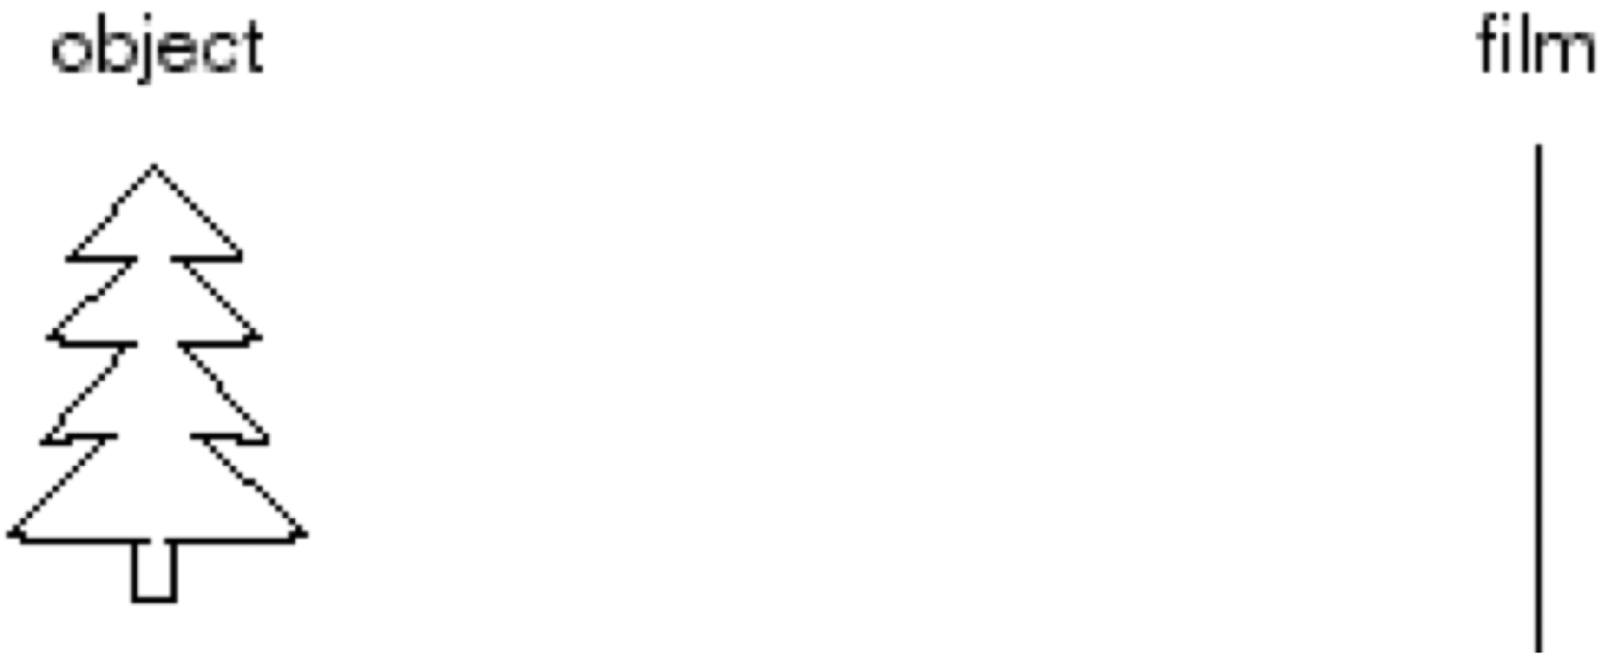
Making a camera
Idea #1: put a piece of film in front of an object.
Source: N. Snavely
Notes:
Let’s try to design a camera that can take these samples of the plenoptic function.
We want to take a picture of this tree.
Here’s an idea. Let’s take a piece of film hold it up in front of an object.
Unfortunately this isn’t going to be a great camera. Why is that?
The light from every point in the scene is going to project onto this film. And it’s all going to get mixed up.
And unfortunately the light is going to hit the same places.
What if we limit this by placing a barrier.

Slide 12
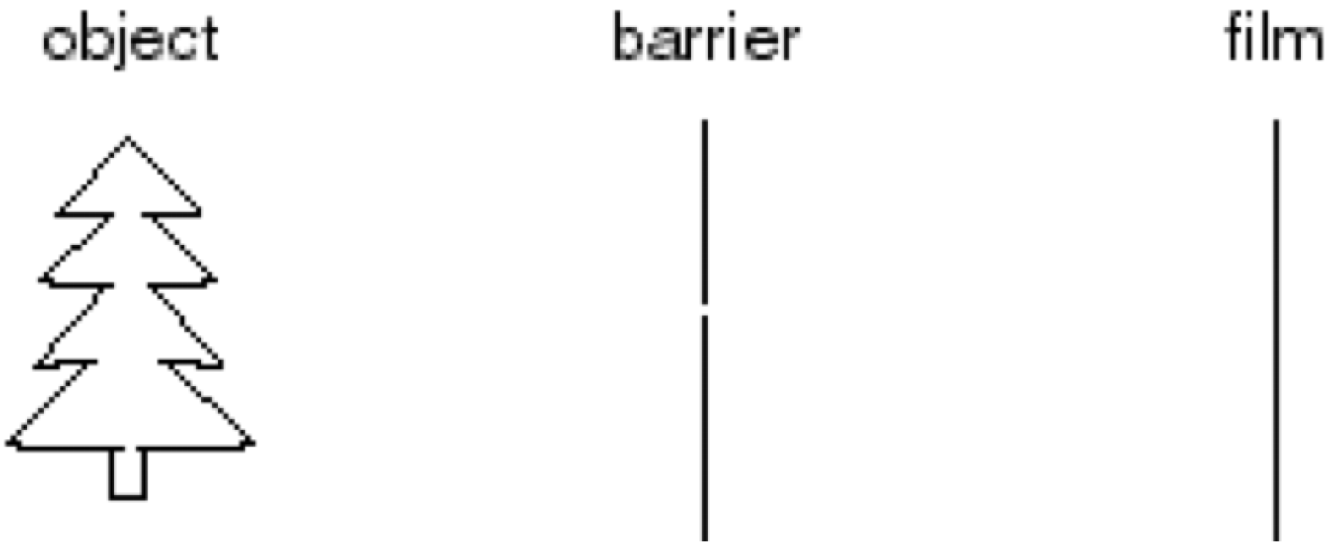
Pinhole camera
Add a barrier to block off most of the rays
  This reduces blurring
  The opening known as the aperture
Source: N. Snavely
Notes:
This works pretty well then. For each point, only one ray is going to make it through the hole.
And it’s funny it’s actually an inverted image.

Slide 13
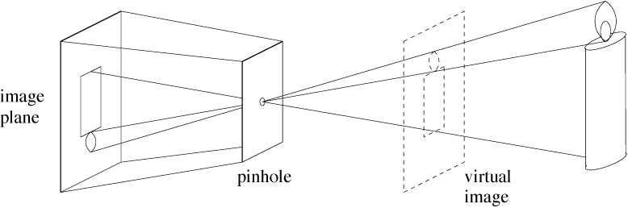
Upside down images
Forsyth & Ponce
Useful concept: virtual image
Source: Freeman, Torralba, Isola
The pinhole camera only allows rays from one point in the scene to strike each point of the paper!
Notes:
This is what this looks like. We have a 3D object, its light passes through the pinhole.
The point to make here is that each point on the image plane sees light from only
one direction, the one that passes through the pinhole.
And you can think of this virtual image here. Flip the image about the pinhole and rotate it.

Slide 14
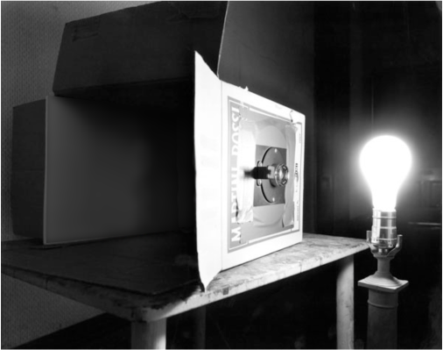
Pinhole camera
Photograph by Abelardo Morell, 1991
Source: Freeman, Torralba, Isola

Slide 15
Pinhole camera
Photograph by Abelardo Morell, 1991
Source: Freeman, Torralba, Isola

Slide 16
Pinhole camera
Photograph by Abelardo Morell, 1991
Source: Freeman, Torralba, Isola

Slide 17
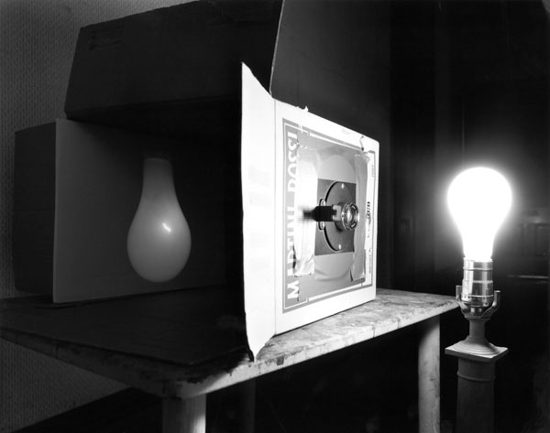
Pinhole camera
Photograph by Abelardo Morell, 1991
Source: Freeman, Torralba, Isola

Slide 18
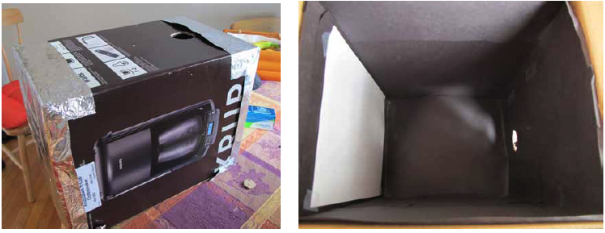
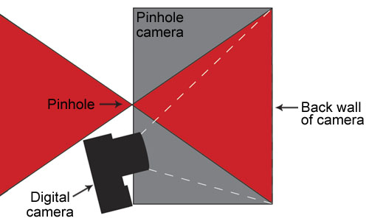
http://www.foundphotography.com/PhotoThoughts/archives/2005/04/pinhole_camera_2.html
Source: Freeman, Torralba, Isola

Slide 19
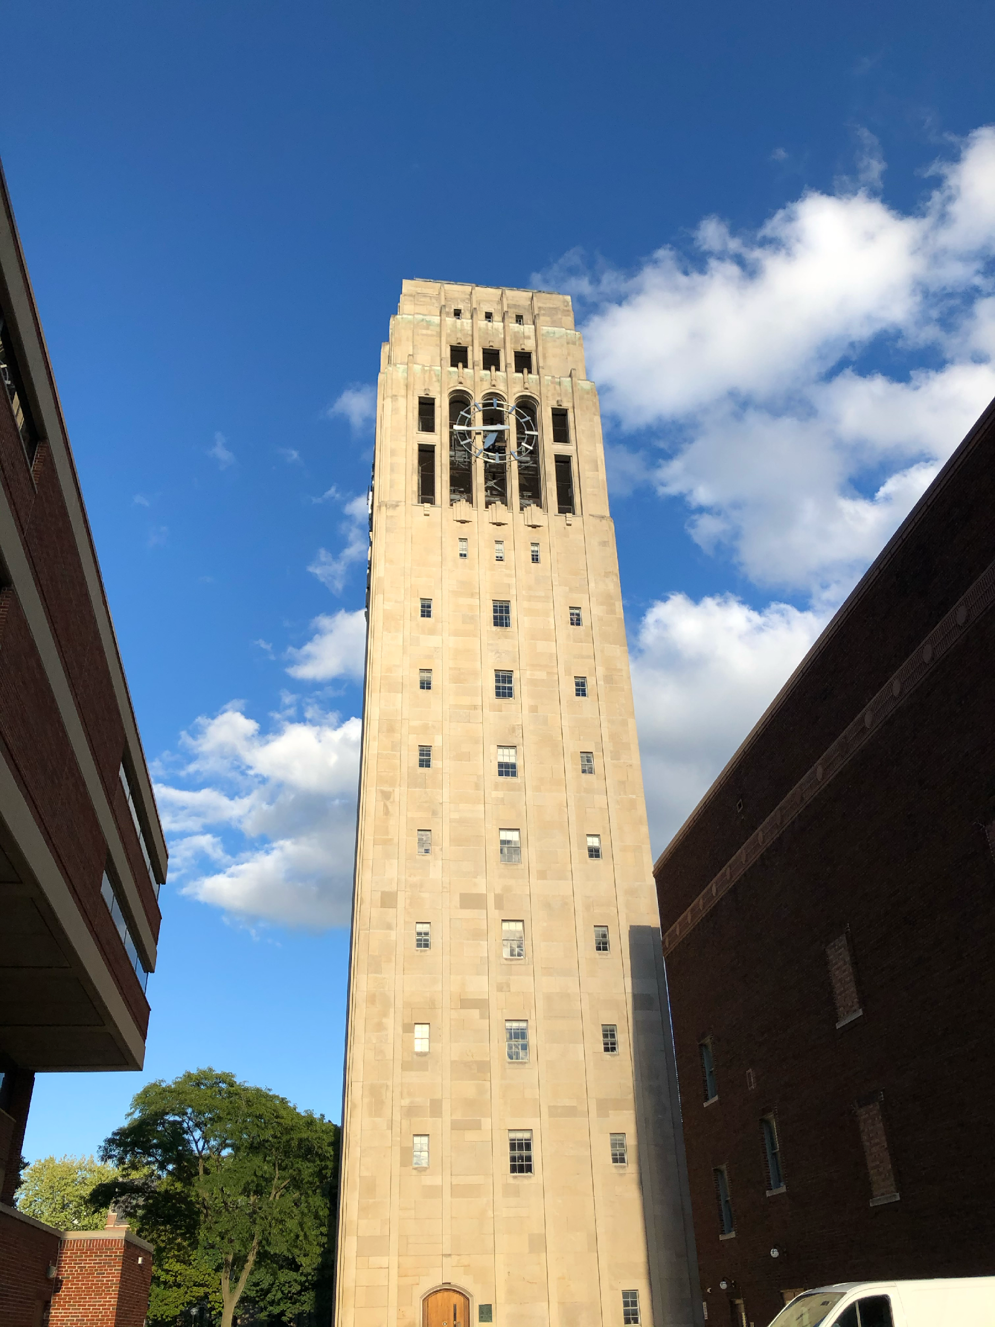
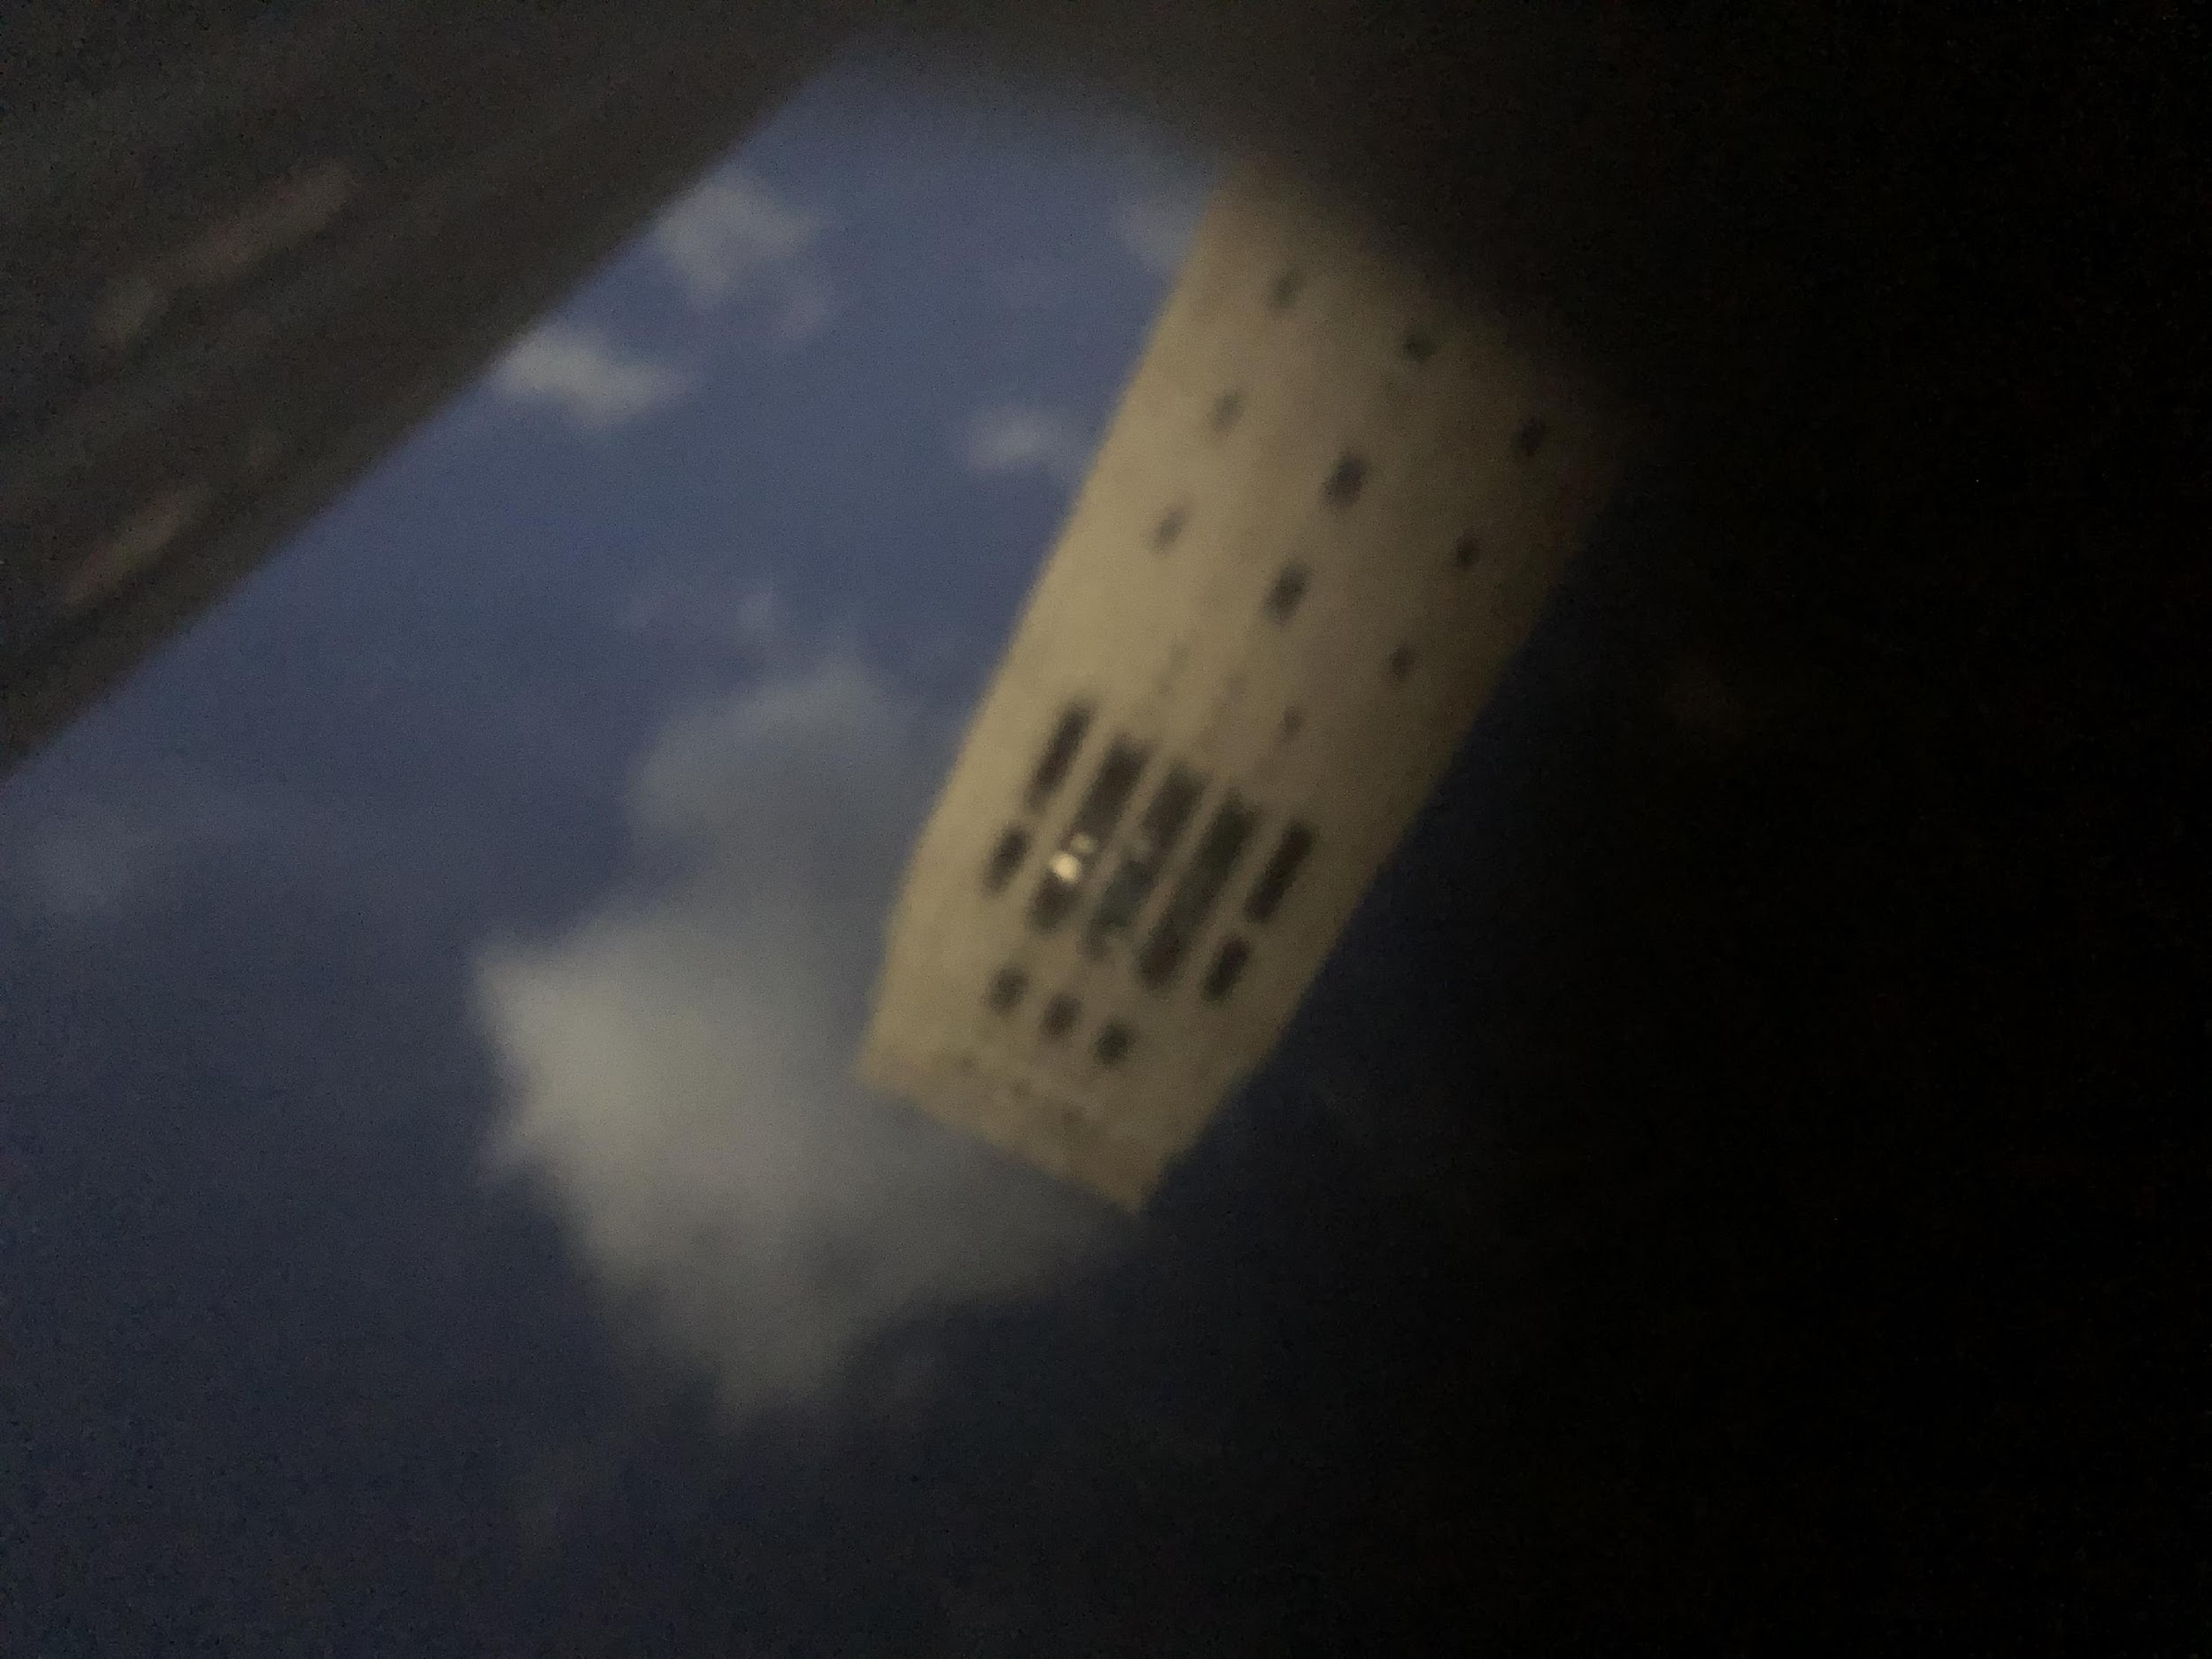
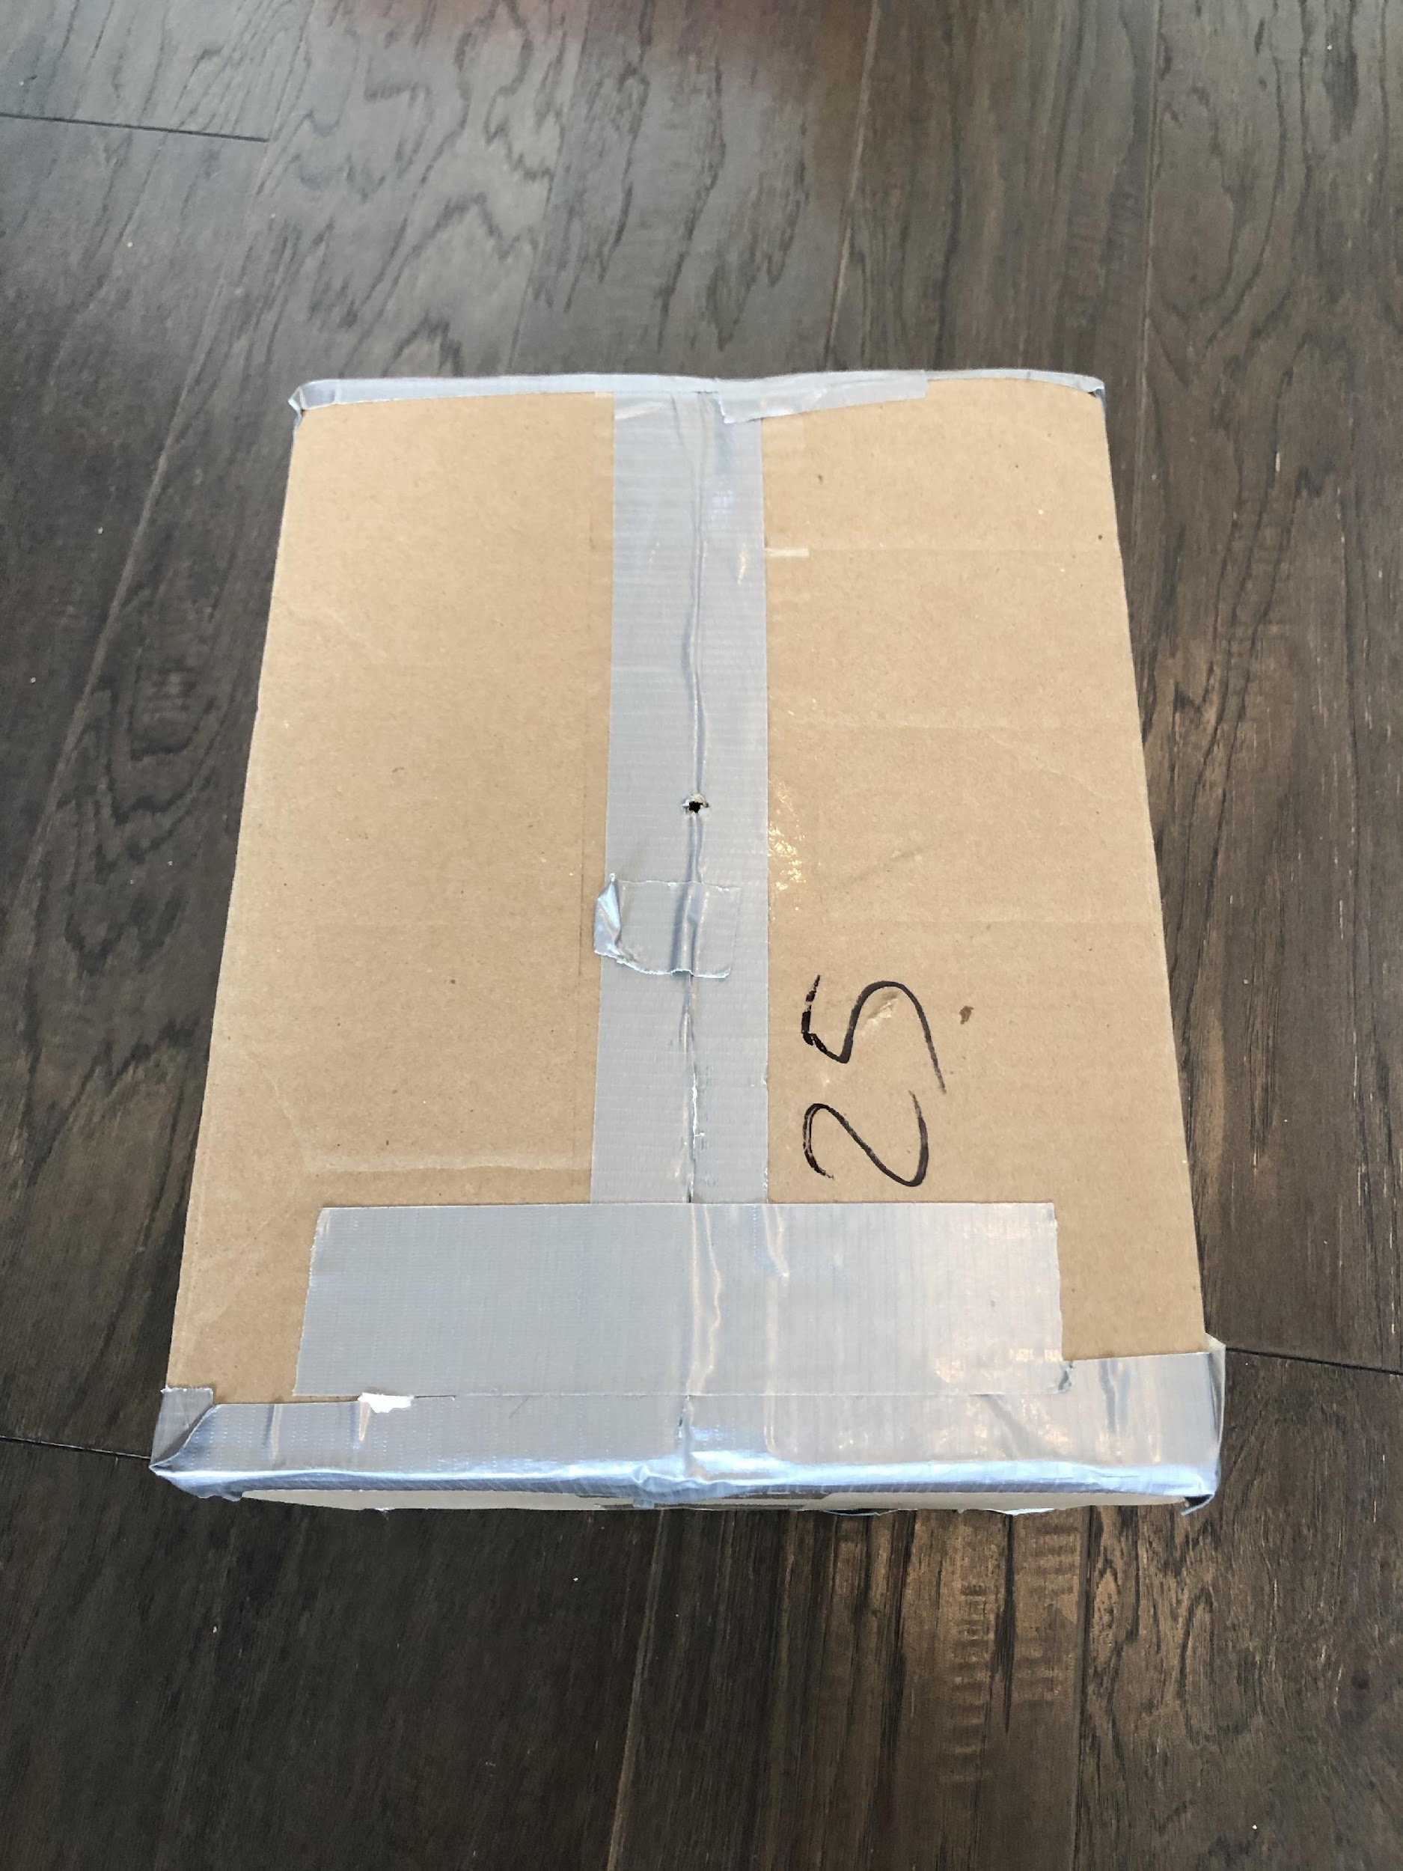

Notes:
I did this, I went to the campus. I took a box. Poked a hole in it. Put my phone in it and took a picture.
Now in principle this aperture should be really really small.

Slide 20
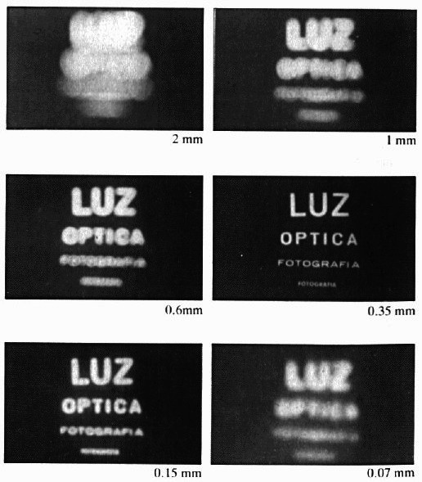
Shrinking the aperture
Why not make the aperture as small as possible?
  Less light gets through
  Diffraction effects...
Source: N. Snavely
Notes:
Of course if you make it too small, you’re not going to get enough light.
And if you make it really small — light is a wave and you’ll get diffraction effects.

Slide 21
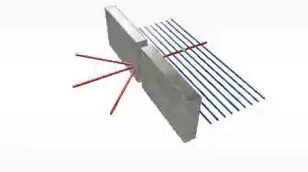
Diffraction
the deviation of waves from straight-line propagation without any change in their energy due to an obstacle or through an aperture

Slide 22
Shrinking the aperture
Source: N. Snavely
Notes:
And if you make it really small — light is a wave and you’ll get diffraction effects.

Slide 23
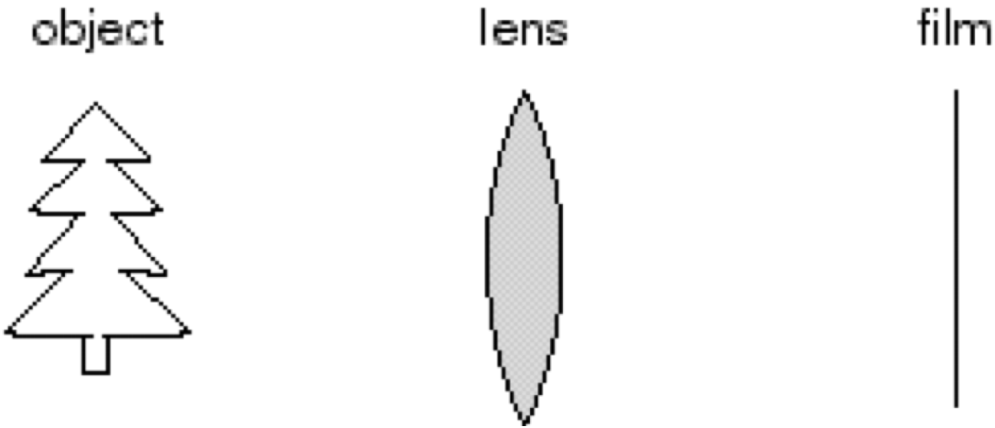
Adding a lens
“circle of
confusion”
A lens focuses light onto the film
  There is a specific distance at which objects are “in focus”
    other points project to a “circle of confusion” in the image
  Changing the shape of the lens changes this distance
Source: N. Snavely
Notes:
light travels more slowly in glass than in air
this causes light to blend
One solution to this is to use a lens. That will let us focus more light onto the film.
The one problem with this is that you start to lose the property that each point only appears once.
If your point is out of focus, so to speak, there’s a circle of confusion — the ray is going to stop in multiple places.
And the shape of the lens determines this.

Slide 24
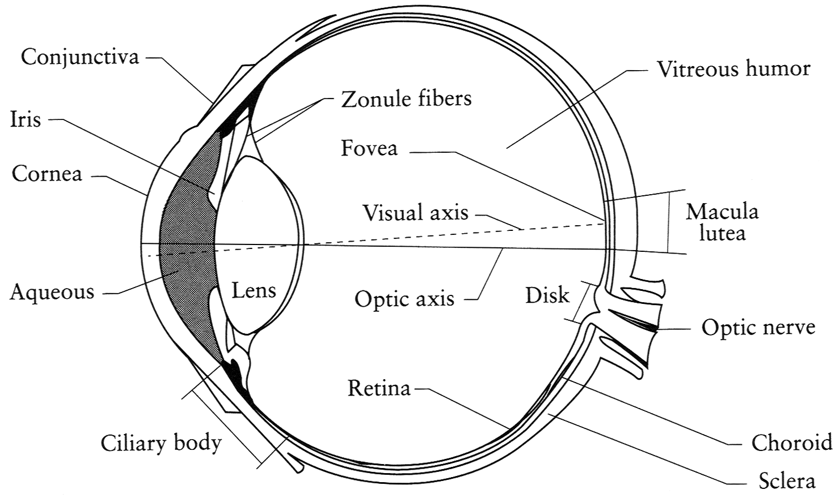
The eye
The human eye is a camera
  Iris - colored annulus with radial muscles
  Pupil - the hole (aperture) whose size is controlled by the iris
  What’s the “film”?
    Photoreceptor cells (rods and cones) in the retina
Source: N. Snavely
Notes:
Retina analogous to the film. Note that the retina is curved
We have the pupil, which is analogous to the hole
Iris sets the size of the hole
We’ll talk more about this later when we discuss color perception
Those are our eyes that are a lot like a camera with a lens.

Slide 25

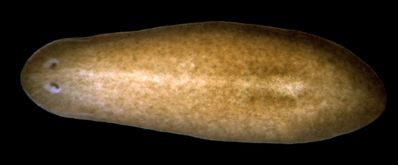
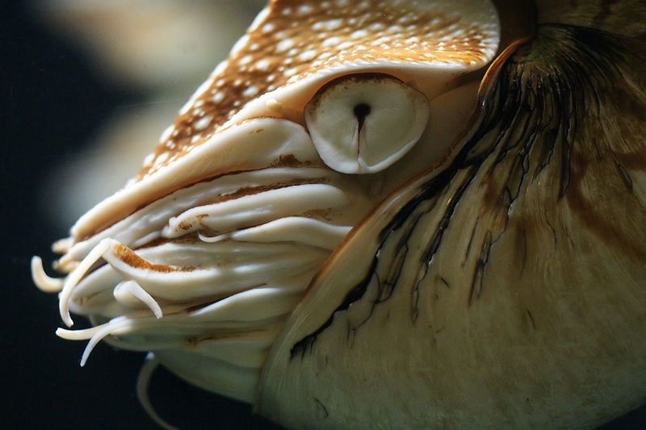
Eyes in nature: eyespots to pinhole camera
http://upload.wikimedia.org/wikipedia/commons/6/6d/Mantis_shrimp.jpg
Source: Freeman, Torralba, Isola
Notes:
Interestingly, the animal kingdom has all kinds of eyes.
There are some that are just like eyespots that are just sensitive to light and maybe a direction.
There are other animals like the nautilus (some cephalopods) that have pinhole cameras.

Slide 26
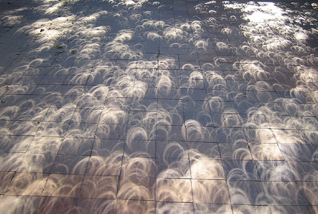
Pinhole cameras in unexpected places
Tree shadow during a solar eclipse
photo credit: Nils van der Burg
http://www.physicstogo.org/index.cfm
Source: Steve Seitz

Slide 27
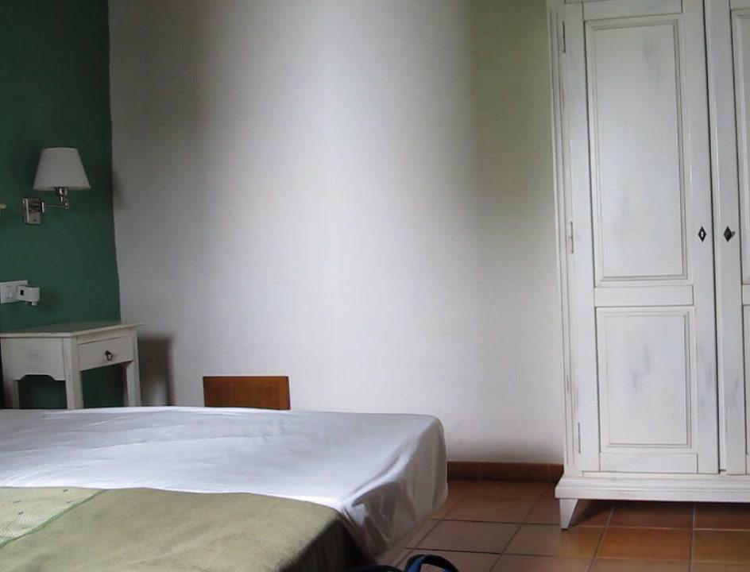
Shadows?
Source: Freeman, Torralba, Isola
Notes:
And interestingly, these pinholes can emerge accidentally.
What’s happening is that the window is acting like a pinhole.

Slide 28
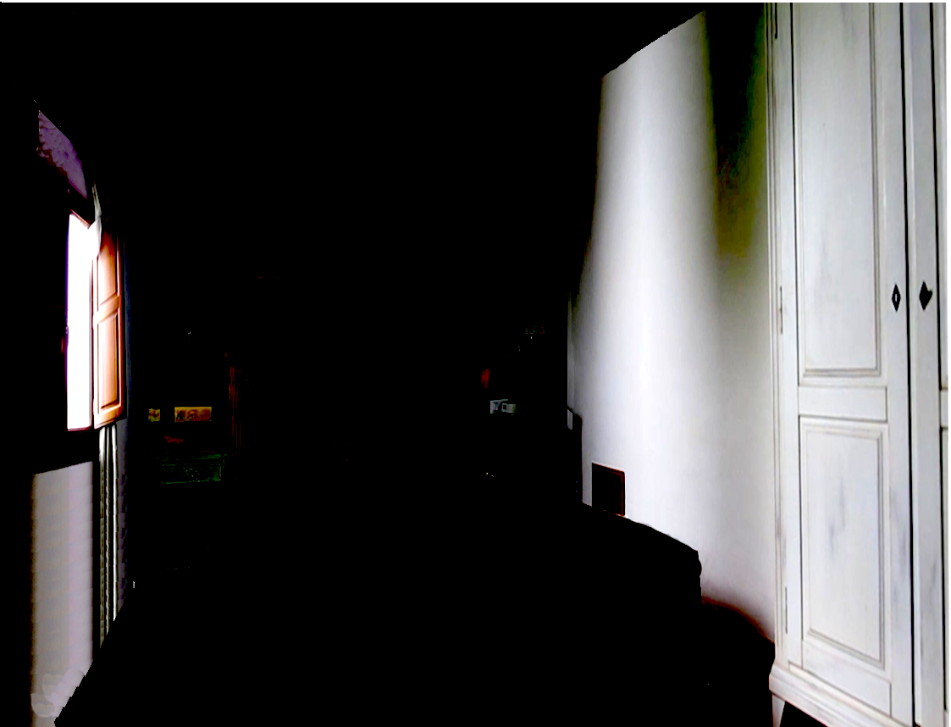
Source: Freeman, Torralba, Isola

Slide 29
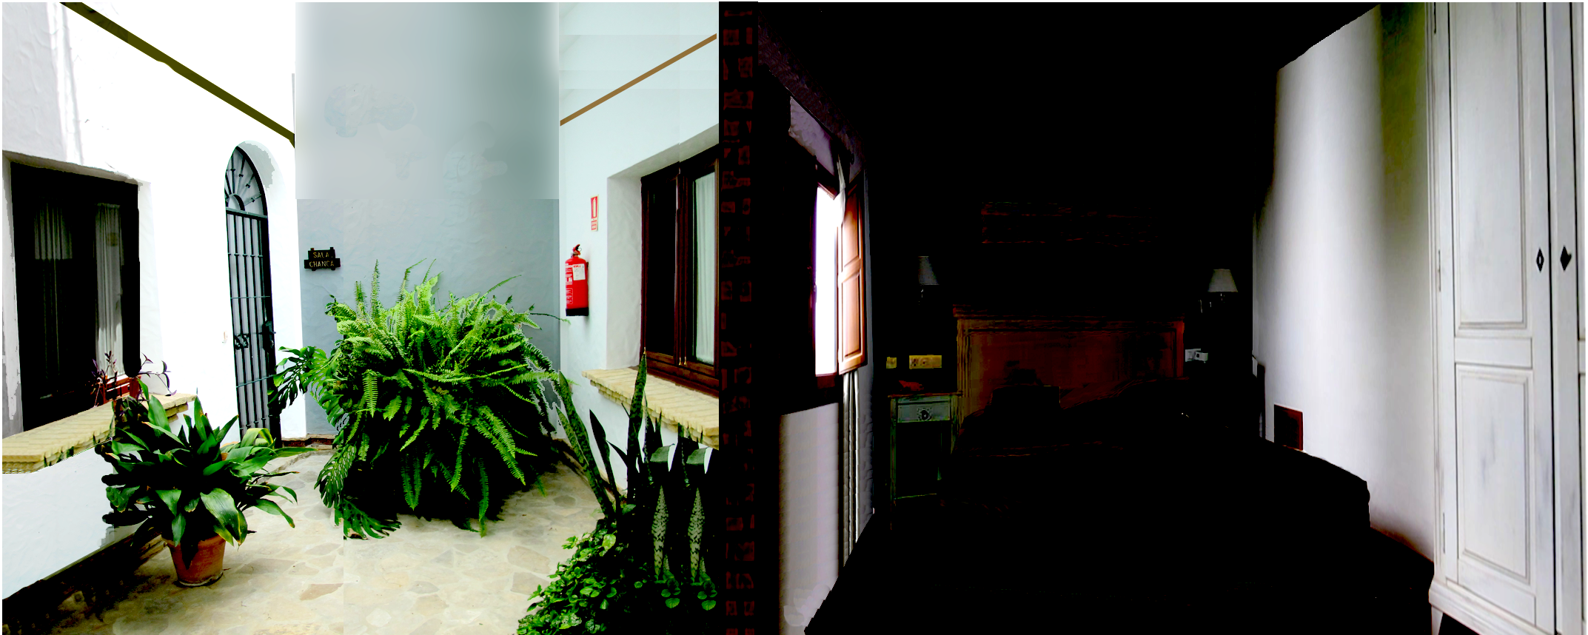
Source: Freeman, Torralba, Isola

Slide 30
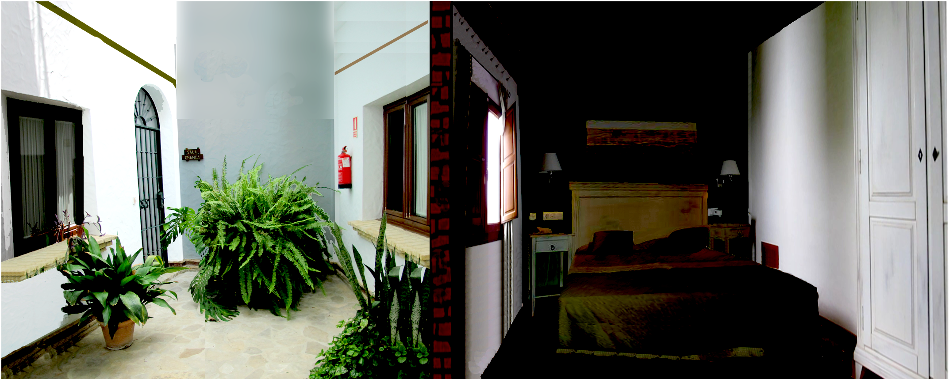
Accidental pinhole camera
Source: Freeman, Torralba, Isola

Slide 31
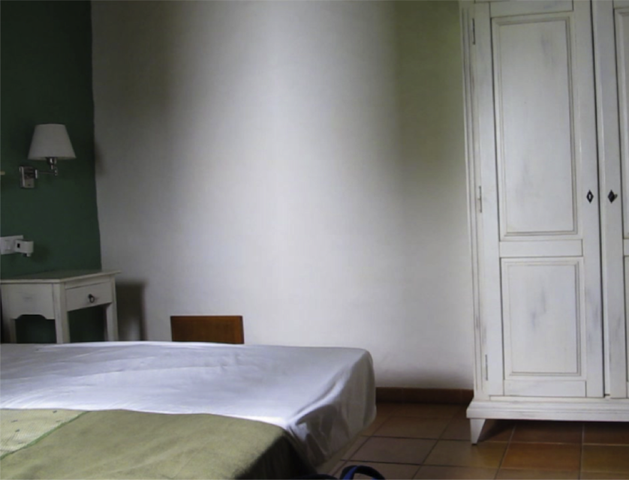
Notes:
If you boarded up the window, this is what you would see.

Slide 32
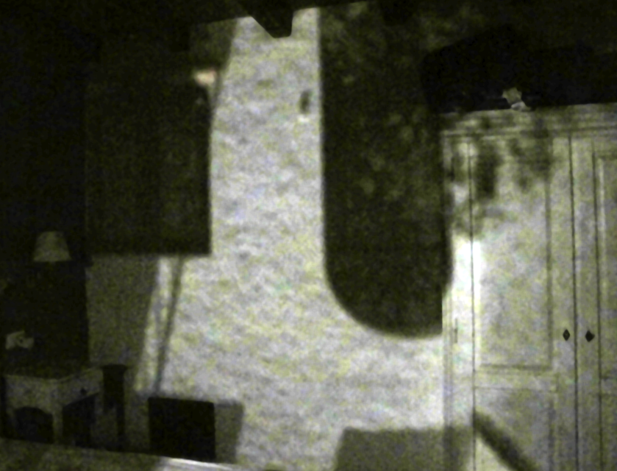

Slide 33
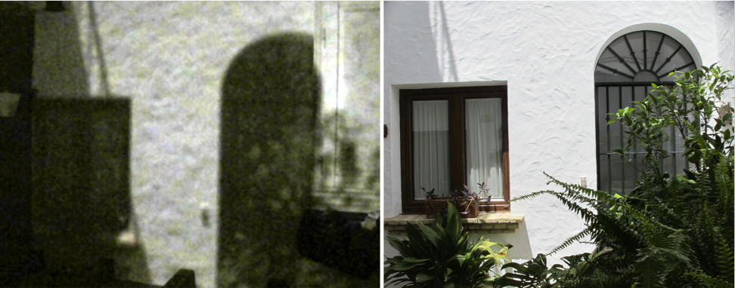
Window turned into a pinhole
View outside
Source: Freeman, Torralba, Isola

Slide 34
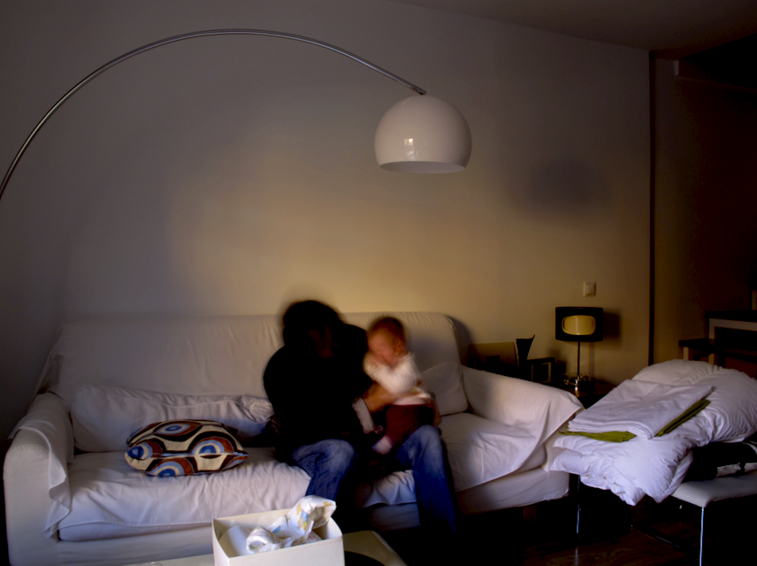
Notes:
This orange tone is not the sun, is a picture of the building in front.

Slide 35
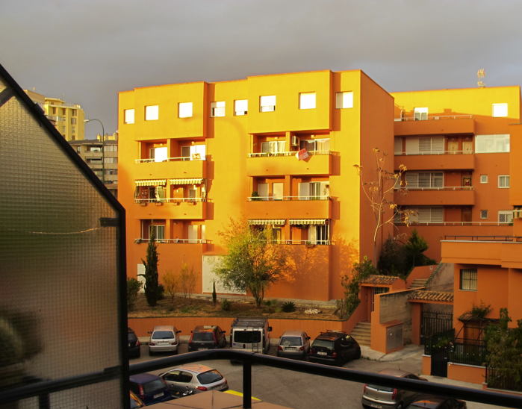

Slide 36
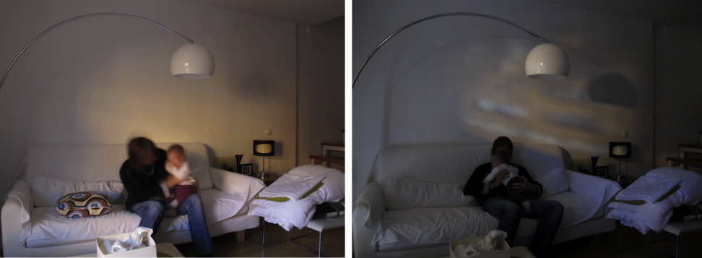
Window open
Window turned into a pinhole
Source: Freeman, Torralba, Isola
Notes:
Interpreting the images projected by the pinhole into a wall with an arbitrary geometry is not intuitive, specially when the camera obscura is created by some accidental arrangement. This, together with the low signal to noise ratio, makes that most images are interpreted as shadows by the untrained eye. These images become (pasan desapercibidas).

Slide 37
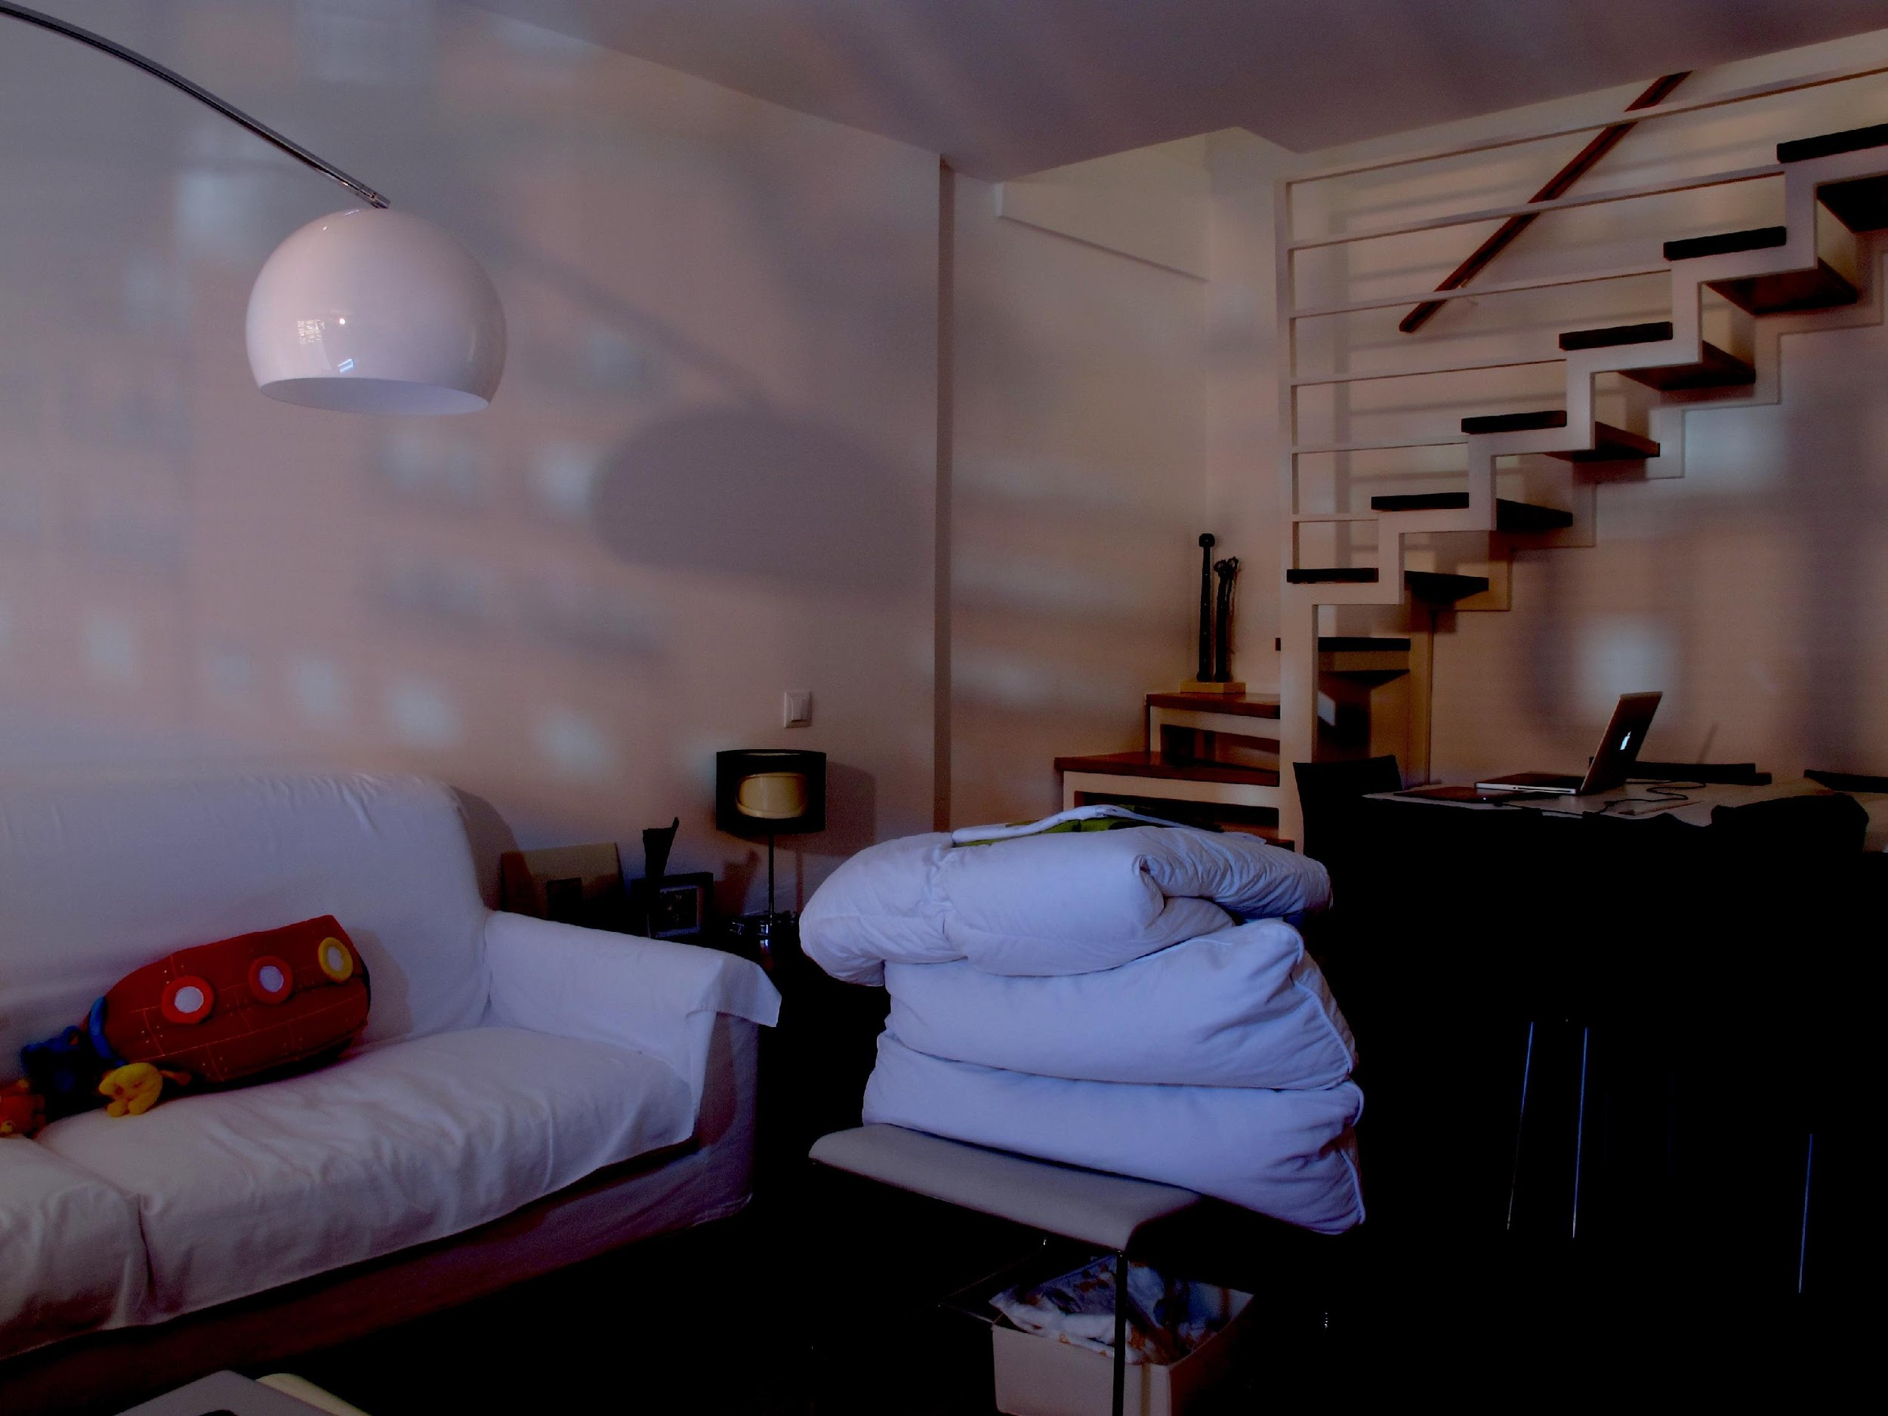

Slide 38
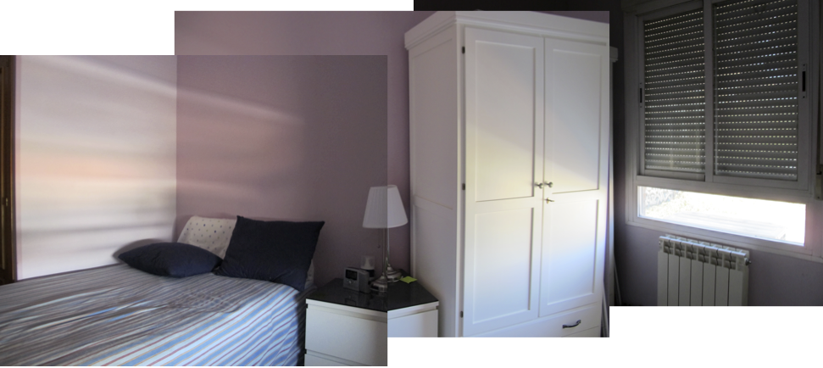
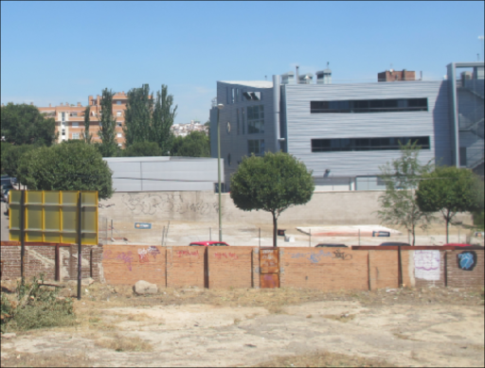

Accidental pinhole camera
*
Aperture
Outside scene
See Zomet, A.; Nayar, S.K. CVPR 2006 for a detailed analysis.
Source: Freeman, Torralba, Isola
Notes:
In general what you’re doing is convolving the image with an aperture

Slide 39
Pinhole and Anti-pinhole cameras
pinhole
…
Anti-pinhole
…
Intensity
location
Adam L. Cohen, 1982
Source: Freeman, Torralba, Isola
Notes:
Interestingly we can actually do the opposite. You can have an anti-pinhole.
Pinhole lets a small amount of light throug from a specific part of a scene.
If you have an open window and an obstruction, you get light from whole scene minus light from location.

Slide 40
Mixed accidental pinhole and anti-pinhole cameras
Notes:
And you can build cameras using anti-pinholes.

Slide 41
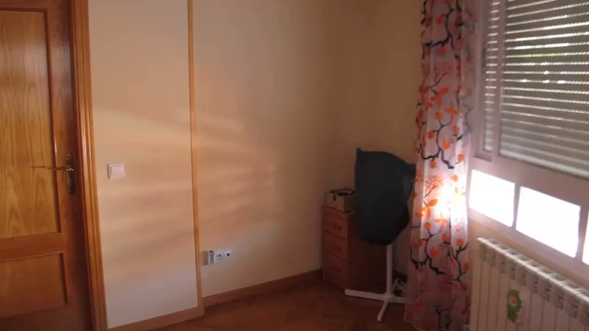
Mixed accidental pinhole and anti-pinhole cameras
Source: Freeman, Torralba, Isola

Slide 42
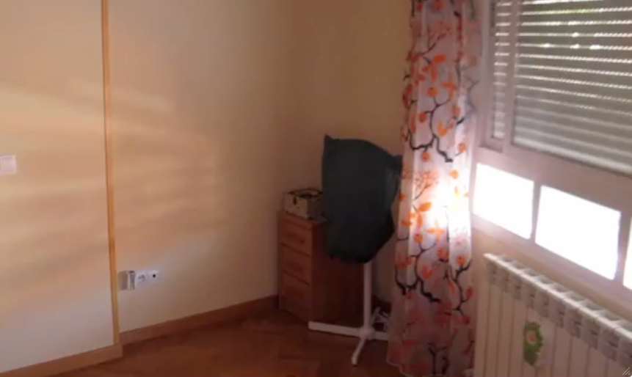
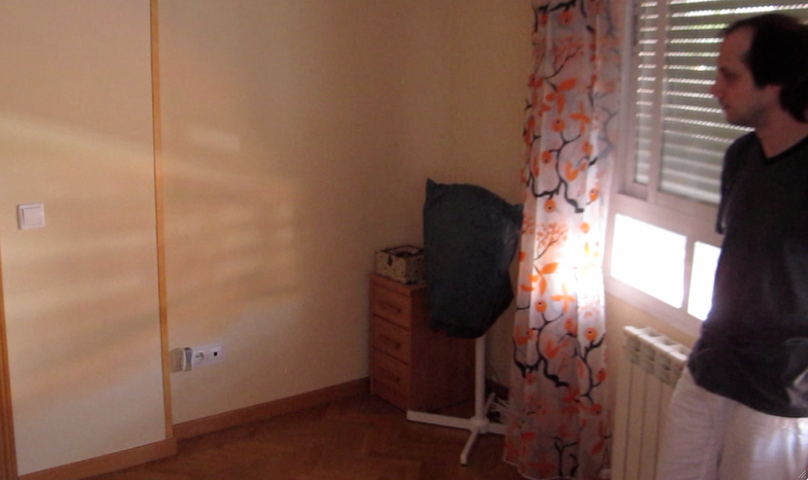
Mixed accidental pinhole and anti-pinhole cameras
Difference image
-
=
-
= ?
Source: Freeman, Torralba, Isola
Notes:
You take an open window.
You step in front of it to obstruct it.
Then you subtract one image from the other.
Remember, at this point in the open window we have the light from everywhere.
Here, we have the light from everywhere except one location.
Subtracting the two gives us an image.

Slide 43
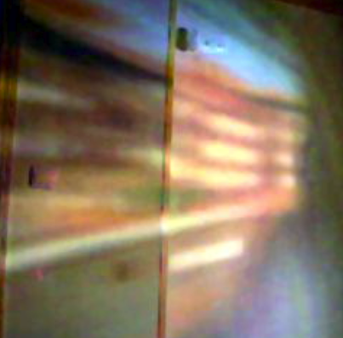
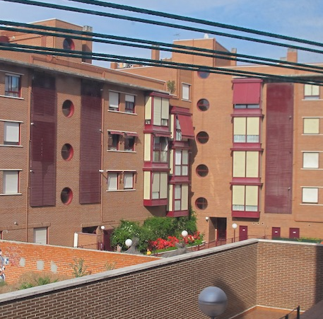
Mixed accidental pinhole and
anti-pinhole cameras
Body as the occluder
View outside the window
Source: Freeman, Torralba, Isola
Notes:
I can not make the recovered image look better to show you that it is a good match, but I can make the real image look worst.

Slide 44
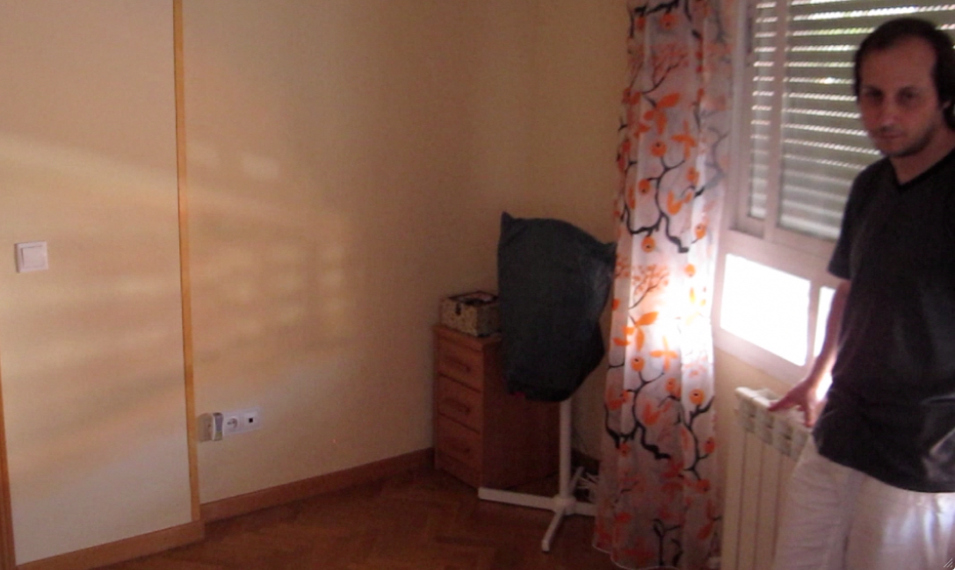
Looking for a small accidental occluder
.
.
.
t2
.
.
.
t3
Source: Freeman, Torralba, Isola
Notes:
And you can do better with a tiny obstruction.

Slide 45
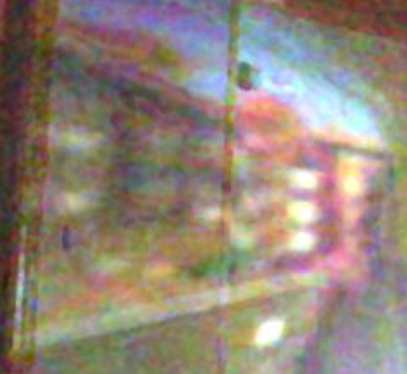
Looking for a small accidental occluder
Body as the occluder
Hand as the occluder
View outside the window
Source: Freeman, Torralba, Isola
Notes:
Something interesting is happening here. We’re getting a 2D image of a 3D structure.

Slide 46
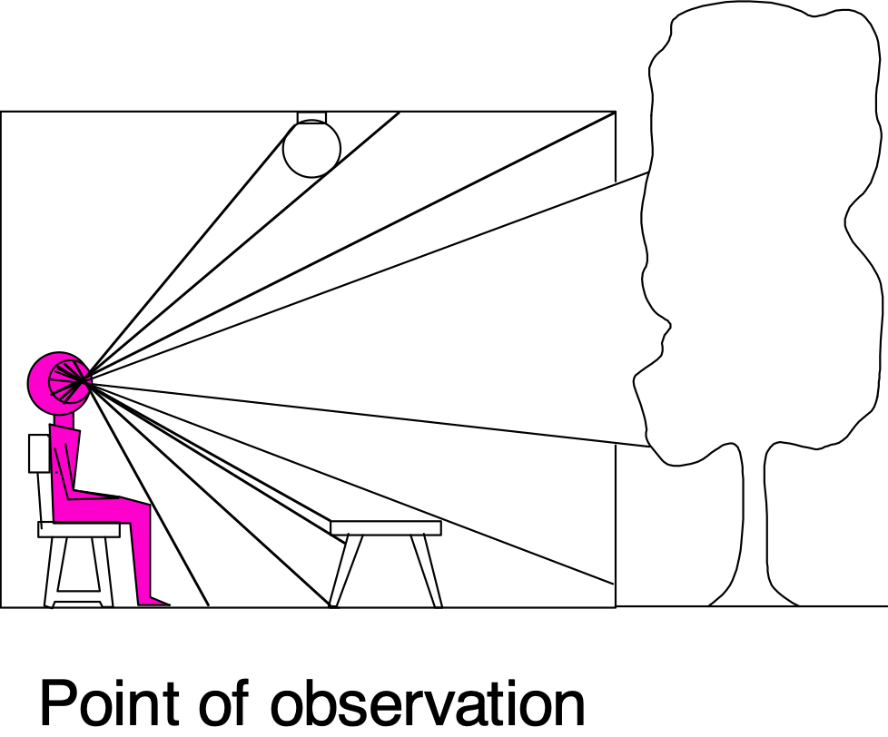
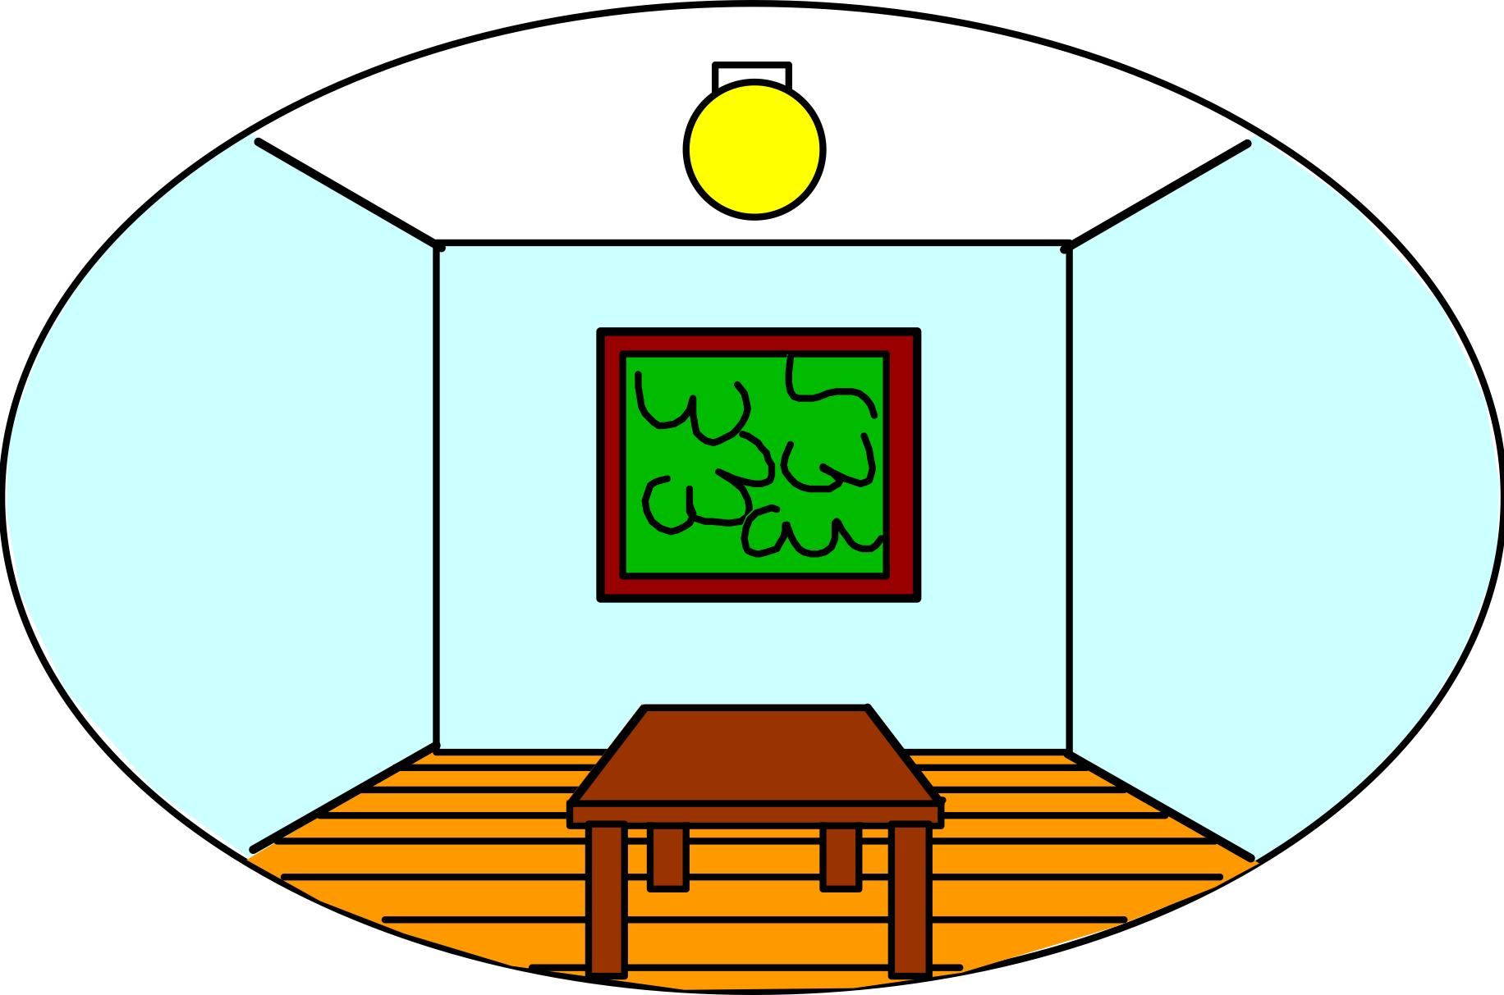
Projection from 3D to 2D
3D world
2D image
Slide by A. Efros
Figure source: Stephen E. Palmer, 2002
What have we lost?
  Angles
  Distances (lengths)
Notes:
Something interesting is happening here. We’re getting a 2D image of a 3D structure.
Let’s try to understand this better. What are we missing?

Slide 47

Projection from 3D to 2D
3D world
2D image
Painted
backdrop
Source: S. Lazebnik

Slide 48

Fooling the eye
Source: S. Lazebnik
Notes:
Of course it’s ambiguous. A lot of artists exploit this.

Slide 49
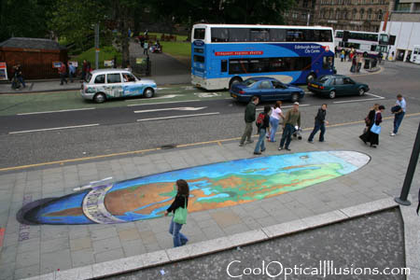
Fooling the eye
Making of 3D sidewalk art: http://www.youtube.com/watch?v=3SNYtd0Ayt0
Source: S. Lazebnik

Slide 50
Müller-Lyer Illusion
Source: N. Snavely, S. Lazebnik
Notes:
And your brain is exploiting all sorts of subtle cues to give you the impression of 3D
This is really deeply embedded in our visual systems.
Probably see these two lines as being the same length.

Slide 51
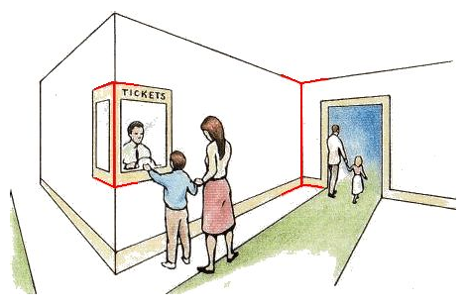
Müller-Lyer Illusion
Source: N. Snavely, S. Lazebnik
Notes:
And your brain is exploiting all sorts of subtle cues to give you the impression of 3D
This is really deeply embedded in our visual systems.
Probably see these two lines as being the same length.

Slide 52
Modeling projection
Center of Projection (COP)
(x’, y’, f)
The coordinate system
  We use the pinhole model as an approximation
  Put the optical center (aka Center of Projection, or COP) at the origin
  Put the Image Plane (aka Projection Plane) in front of the COP
  The camera looks down the positive z-axis, and the y-axis points down
(X, Y, Z)
Z
f
x
Image Plane
y
Source: N. Snavely
Notes:
Let’s think geometrically about what’s going on.
We know that this would give us an upside down image. [draw]
This way the image is right-side-up. But it’s kind of confusing to think of things as being upside down. So let’s flip and rotate it again as a virtual image just like we saw before.
There’s a really important physical parameter here, the focal length. That’s the distance from the center of projection to the film.

Slide 53
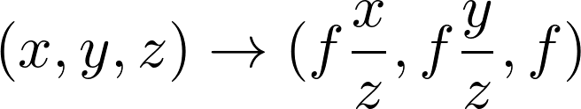
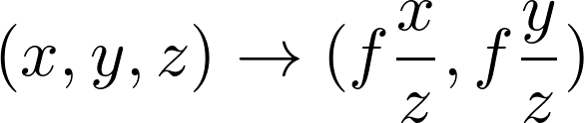
Modeling projection
Center of Projection (COP)
(x’, y’, f)
Projection equations
  Compute intersection with image plane of ray from (X,Y,Z) to COP
  Derived using similar triangles
  We get the projection by throwing out the last coordinate:
(X, Y, Z)
Z
f
x
Image Plane
y
Source: N. Snavely
Notes:
We can ask where a point in 3D ends up getting projected to in 2D.
You can ask how a point in 3D (x, y, z) ends up on the image.
x’ / f = x / z -> x’ = f x/z
This way the image is right-side-up

Slide 54
Perspective projection
Y
(0,0,0)
Z
Source: Freeman, Torralba, Isola
Notes:
Let’s derive this here. Let’s only look at the Y coordinate.
We’ll draw a ray
Kind of clunky. We’re going to have to divide by Z

Slide 55
Perspective projection
Y
y ?
(0,0,0)
Z
f
Similar triangles: y / f = Y / Z
y = f Y/Z
How can we represent this more compactly?
Source: Freeman, Torralba, Isola
Notes:
Let’s derive this here. Let’s only look at the Y coordinate.
We’ll draw a ray
Kind of clunky. We’re going to have to divide by Z

Slide 56
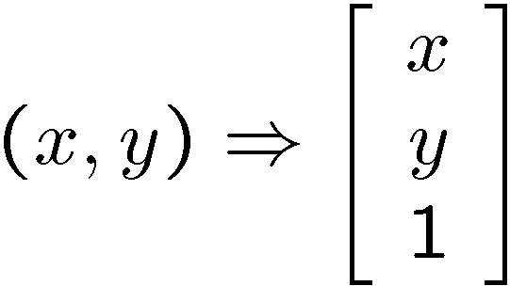
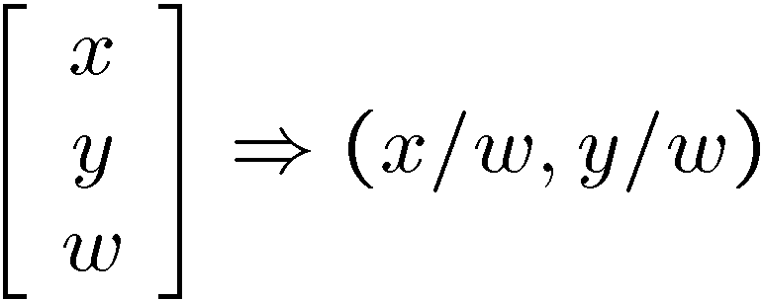
Homogeneous coordinates
(x, y, w)
Trick: add one more coordinate:
homogeneous plane
w = 1
(x/w, y/w, 1)
homogeneous image
coordinates
Converting from homogeneous coordinates
Source: N. Snavely
Notes:
Let’s use a trick kind of like the one we’ve already seen in machine learning.
We’ll just tack on an extra coordinate
We’ll call this point a homogeneous image coordinate.
Now we’ll make a rule: to go from homogeneous coordinates to image coordinates, we’ll divide by whatever that last value, w, is.
If w = 1, we throw it away
Geometrically what’s going on here is we’ll normalize the vector to be at z=1
We’ll see in a second that this helps us solve our problem.

Slide 57
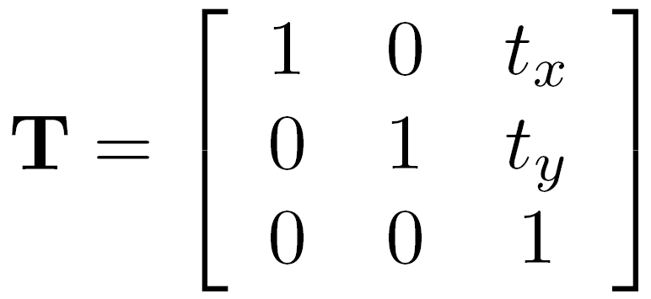
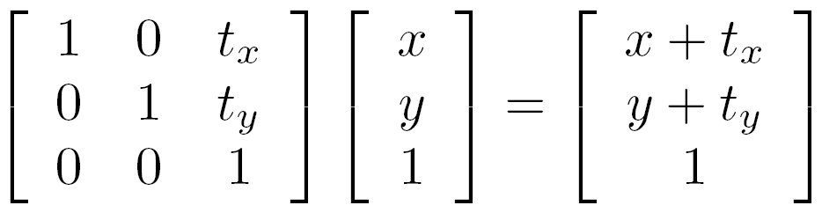
Application: translation with homogeneous coordinates
Source: N. Snavely
Notes:
But it also has a lot of other nice properties.
It lets us

Slide 58
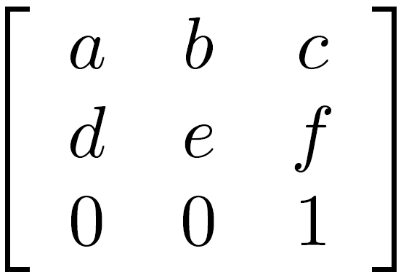
Affine transformations
any transformation represented by a 3x3 matrix with last row [ 0 0 1 ] we call an affine transformation
Source: N. Snavely
Notes:
It also lets us represent affine transformations.

Slide 59
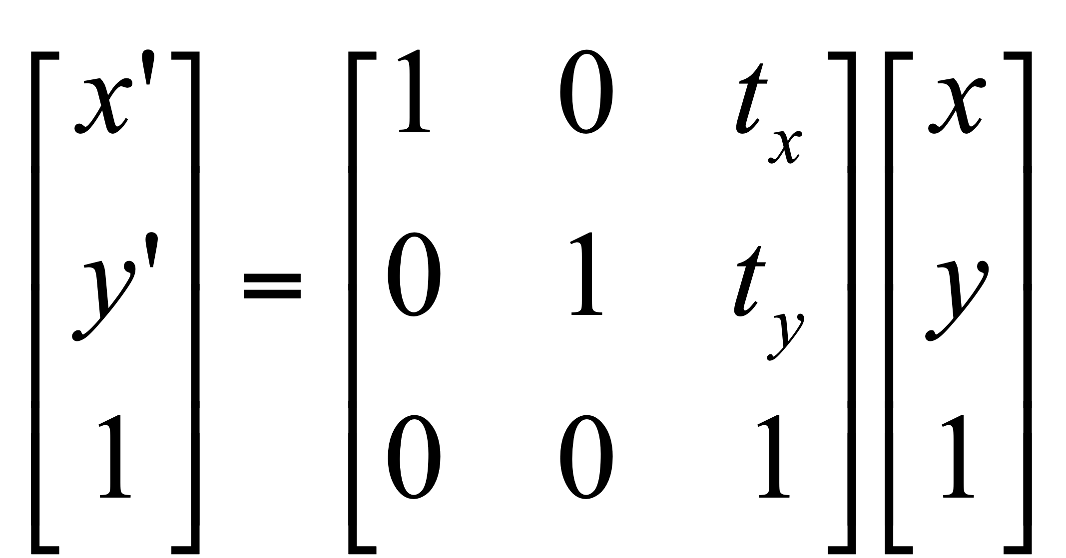



Examples of Affine Transformations
Translate
Scale
2D in-plane rotation
Shear
Source: N. Snavely

Slide 60


Perspective Projection
Projection is a matrix multiply using homogeneous coordinates:
divide by third coordinate
This is known as perspective projection
  The matrix is the projection matrix
Source: N. Snavely
Notes:
$$
\begin{bmatrix}
1 & 0 & 0 & 0 \\
0 & 1 & 0 & 0 \\
0 & 0 & 1/f & 0
\end{bmatrix}
\begin{bmatrix}
x \\
y \\
z \\
1
\end{bmatrix}
=
\begin{bmatrix}
x \\
y \\
z / f
\end{bmatrix}
$$

Slide 61


Perspective Projection
How does scaling the projection matrix change the transformation?
What if we
scale by f?
Scaling a projection matrix produces an equivalent projection matrix!
Source: N. Snavely

Slide 62



Orthographic projection
Special case of perspective projection
  Distance from the COP to the PP is infinite
  Good approximation for telephoto optics
  Also called “parallel projection”: (x, y, z) → (x, y)
  What’s the projection matrix?
Image
World
Source: N. Snavely

Slide 63



Orthographic projection
Source: N. Snavely

Slide 64



Perspective projection
Source: N. Snavely

Slide 65
Projection properties
Many-to-one: any points along same ray map to same point in image
Points → points
Lines → lines (collinearity is preserved)
  But line through focal point projects to a point
Planes → planes (or half-planes)
  But plane through focal point projects to line
Source: N. Snavely
Notes:
Lot of properties you might expect.

Slide 66


Projection properties
Parallel lines converge at a vanishing point
  Each direction in space has its own vanishing point
  But lines parallel to the image plane remain parallel
Source: N. Snavely
Notes:
Questions?

Slide 67


Camera parameters
How can we model the geometry of a camera?
Camera
(x, y, z)
COP
Three important coordinate systems:
World coordinates
Camera coordinates
Image coordinates
“The World”
How do we project a given world point (x, y, z) to an image point?
Source: N. Snavely

Slide 68

Coordinate frames
World coordinates
Camera coordinates
Image coordinates
Source: N. Snavely
Figure credit: Peter Hedman

Slide 69
Camera parameters
To project a point (x, y, z) in world coordinates into a camera
First transform (x, y, z) into camera coordinates
Need to know
  Camera position (in world coordinates)
  Camera orientation (in world coordinates)
Then project into the image plane to get image (pixel) coordinates
  Need to know camera intrinsics
Source: N. Snavely

Slide 70





Camera parameters
A camera is described by several parameters
  Translation T of the optical center from the origin of world coords
  Rotation R of the image plane
  focal length f, principal point (c_{x}, c_{y}), pixel aspect size α
  blue parameters are called “extrinsics,” red are “intrinsics”
Projection equation
  The projection matrix models the cumulative effect of all parameters
  Useful to decompose into a series of operations
identity matrix
intrinsics
projection
rotation
translation
  The definitions of these parameters are not completely standardized
    especially intrinsics—varies from one book to another
Source: N. Snavely
Notes:
We’re going to combine this into a single matrix.

Slide 71










Projection matrix
=
0
(in homogeneous image coordinates)
Source: N. Snavely

Slide 72
Extrinsics
How do we get the camera to “canonical form”?
  (Center of projection at the origin, x-axis points right, y-axis points up, z-axis points backwards)
Step 1: Translate by -c
0
Source: N. Snavely

Slide 73


Extrinsics
How do we get the camera to “canonical form”?
  (Center of projection at the origin, x-axis points right, y-axis points up, z-axis points backwards)
Step 1: Translate by -c
How do we represent translation as a matrix multiplication?
0
Source: N. Snavely

Slide 74

Extrinsics
How do we get the camera to “canonical form”?
  (Center of projection at the origin, x-axis points right, y-axis points up, z-axis points backwards)
Step 1: Translate by -c
Step 2: Rotate by R
0
3x3 rotation matrix
Source: N. Snavely

Slide 75
Extrinsics
How do we get the camera to “canonical form”?
  (Center of projection at the origin, x-axis points right, y-axis points up, z-axis points backwards)
Step 1: Translate by -c
Step 2: Rotate by R
0
(with extra row/column of [0 0 0 1])
Source: N. Snavely

Slide 76






Perspective projection
(converts from 3D rays in camera coordinate system to pixel coordinates)
(intrinsics)
in general,
(upper triangular matrix)
: aspect ratio (1 unless pixels are not square)
: skew (0 unless pixels are shaped like rhombi/parallelograms)
Source: N. Snavely
: principal point ((w/2,h/2) unless optical axis doesn’t intersect projection plane at image center)

Slide 77

Typical intrinsics matrix
2D affine transform corresponding to a scale by f (focal length) and a translation by (c_{x}, c_{y}) (principal point)
Maps 3D rays to 2D pixels
Source: N. Snavely

Slide 78






Focal length
Can think of as “zoom”
Also related to field of view
24mm
50mm
200mm
800mm
Source: N. Snavely

Slide 79

Changing focal length
Source: N. Snavely
Notes:
http://www.stsite.com/camera/telephoto-wideangle.php
Wide angle deepens
Telephoto magnifies and pulls it in

Slide 80

http://petapixel.com/2013/01/11/how-focal-length-affects-your-subjects-apparent-weight-as-seen-with-a-cat/
Source: N. Snavely

Slide 81


Projection matrix
intrinsics
projection
rotation
translation
This part converts 3D points in world coordinates to 3D rays in the camera’s coordinate system. There are 6 parameters represented (3 for position/translation, 3 for rotation).
The K matrix converts 3D rays in the camera’s coordinate system to 2D image points in image (pixel) coordinates.
Source: N. Snavely

Slide 82


Projection matrix
intrinsics
projection
rotation
translation
(sometimes called t)
Source: N. Snavely

Slide 83
Projection matrix
=
0
(in homogeneous image coordinates)
Source: N. Snavely

Slide 84

Distortion
No distortion
Pin cushion
Barrel
Radial distortion of the image
  Caused by imperfect lenses
  Deviations are most noticeable for rays that pass through the edge of the lens
Source: N. Snavely

Slide 85


Source: N. Snavely

Slide 86




Modeling distortion
Project
to “normalized”
image coordinates
Apply radial distortion
Apply focal length
translate image center
To model lens distortion
  Use above projection operation instead of standard projection matrix multiplication
Source: N. Snavely

Slide 87


Correcting radial distortion
from Helmut Dersch

Slide 88
Next class: More geometry!

